Slide 1
建立物理仿真工程

Slide 2
准备工作
注册Nvidia开发者账户，并通过PhysX开发者申请认证
下载PhysX源代码工程
使用对应版本的Compiler来编译工程

Slide 3
新建工程准备
将\PhysX-3.4\PhysX_3.4\Include和\PhysX-3.4\PxShared\include设置为include目录
将\PhysX-3.4\PhysX_3.4\Lib和\PhysX-3.4\PxShared\lib设置为lib目录
将PhysX-3.4\PhysX_3.4\Bin和PhysX-3.4\PxShared\bin在Debugging里面的environment参数中设置为path

Slide 4
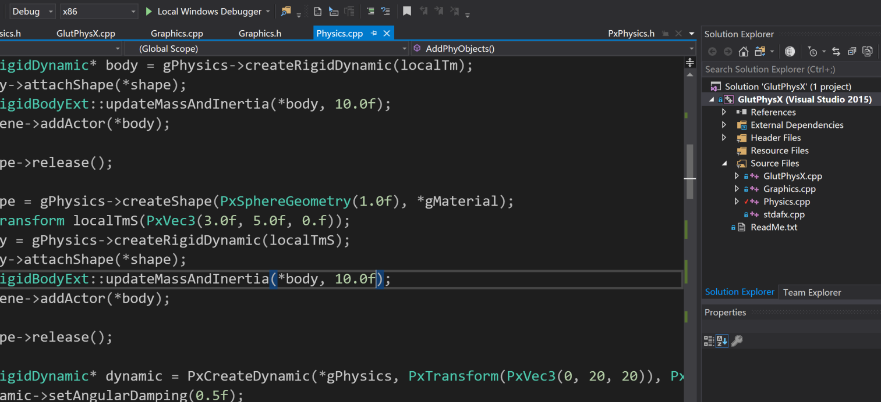
以Glut为例从头开始新建工程

Slide 5
PhysX基本元素
The most important PhysX objects are scenes and actors
A scene is PhysX' representation of the world, and actors are the individual elements of that world
A scene also supports geometric queries, such as raycasts and volume overlap checks, against the actors it contains

Slide 6
scene
The PxScene object is the representation of the world in PhysX.
Creating the scene requires a number of immutable parameters to be specified in the PxSceneDesc struct.

Slide 7
PxSceneDesc sceneDesc(gPhysics->getTolerancesScale());
sceneDesc.gravity = PxVec3(0.0f, -9.81f, 0.0f);
gDispatcher = PxDefaultCpuDispatcherCreate(2);
sceneDesc.cpuDispatcher = gDispatcher;
sceneDesc.filterShader = PxDefaultSimulationFilterShader;
gScene = gPhysics->createScene(sceneDesc);

Slide 8
The Simulation Loop
// update PhysX
void stepPhysics(PxReal timeStep)
{
if (timeStep <= 0)
return;
gScene->simulate(timeStep);
gScene->fetchResults(true);
}

Slide 9
Materials
All physical objects have at least one material, which defines the friction and restitution properties used to resolve a collision with the objects. To create a material, call PxPhysics::createMaterial():
gMaterial = gPhysics->createMaterial(0.5f, 0.5f, 0.6f);

Slide 10
Rigid Actors
Rigid actors are of two principal kinds: static and dynamic, corresponding to the PhysX classes PxRigidStatic and PxRigidDynamic
Static actors are immovable by the simulation, whereas dynamic actors have their positions updated by the simulation when simulate() is called
Dynamic actors may be controlled either directly by the application updating their position on a frame-by-frame basis (such actors are called kinematic), or by the simulation engine according to Newton's Laws of Motion.
PhysX provides helper methods in PxSimpleFactory.h to quickly create simple actors

Slide 11
To procedurally create and simulate more complex actors, follow these steps:
create a PxRigidStatic or PxRigidDynamic object through the PxPhysics object, specifying its pose (orientation and position) in the world
create one or more PxShapes to define the collision geometry of the actor
for dynamics, update the mass and inertia properties of the actor
customize the properties of the actor and shapes as necessary
add the actor to the scene

Slide 12
Shapes
Shapes describe the spatial extent and collision properties of actors
Each shape contains a PxGeometry object and a reference to a PxMaterial
A shape may also have a transform relative to its parent actor
To create an actor with several shapes (sometimes referred to as a compound), just call PxRigidActor::createShape() several times
There are no persistence requirements on the PxGeometry instance that is passed as a function argument in PxRigidActor::createShape()
The PhysX SDK takes a copy of the PxGeometry object rather than maintaining a reference to it.

Slide 13
PxShape* shape = gPhysics->createShape(PxBoxGeometry(1.0f, 1.0f, 1.0f), *gMaterial);
PxTransform localTm(PxVec3(-3.0f, 5.0f, 0.f));
PxRigidDynamic* body = gPhysics->createRigidDynamic(localTm);
body->attachShape(*shape);
PxRigidBodyExt::updateMassAndInertia(*body, 10.0f);
gScene->addActor(*body);
shape->release();

Slide 14
Kinematic triangle meshes
It is possible to create a kinematic PxRigidDynamic which can have a triangle mesh (plane, heighfield) shape
If this shape has a simulation shape flag, this actor must stay kinematic. If you change the flag to not simulated, you can switch even the kinematic flag.

Slide 15
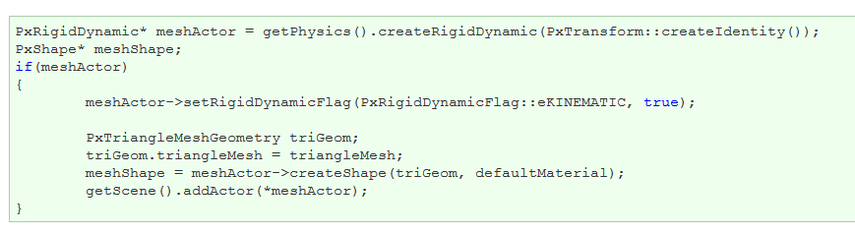

Slide 16
Geometries
The PxGeometry class defines a volume or surface with a fixed position and orientation.
For bulk objects, such as a convex mesh, triangle mesh or height field, PhysX allows multiple PxGeometry objects to refer to a single mesh or height field, and supports per-instance scaling.

Slide 17
Detaching Shapes
Since a PxShape must belong to a PxActor, need creates a new actor, whose global pose is that of the original shape. The geometry and material for the new shape are retrieved from the original shape:
PxShape* shape = gPhysics->createShape(PxBoxGeometry(1.0f, 1.0f, 1.0f), *gMaterial);
PxTransform localTm(PxVec3(-3.0f, 5.0f, 0.f));
PxRigidDynamic* body = gPhysics->createRigidDynamic(localTm);
body->attachShape(*shape);
PxRigidBodyExt::updateMassAndInertia(*body, 10.0f);
gScene->addActor(*body);
shape->release();

Slide 18

Convex Meshes
A convex mesh contains an array of vertices, an array of faces, and an index buffer which concatenates the vertex indices for each face. To unpack a convex mesh, the first step is to extract the shared convex mesh:

Slide 19

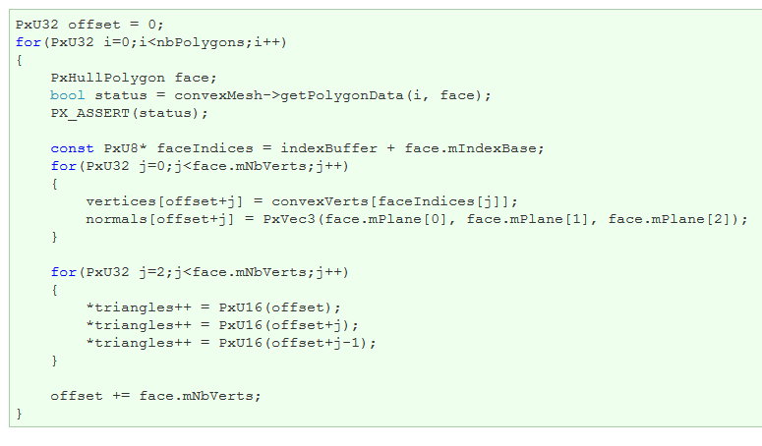
obtain references to the vertex and index buffers:
iterate over the array of faces to triangulate them:

Slide 20
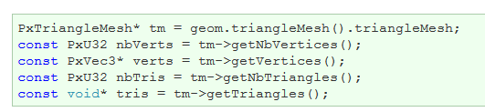
Triangle Meshes
Triangle meshes contain arrays of vertices and index triplets which define the triangles by indexing into the vertex buffer. The arrays can be accessed directly from the shared triangle mesh:

Slide 21
Height Fields
The storage of height field data is platform-dependent, and therefore direct access to the height field samples is not provided. Instead, calls are provided to render the samples to a user-supplied buffer.
Again, the first step is to retrieve the geometry for the height field:

Slide 22
The height field has three scaling parameters:
const PxReal rs = geometry.rowScale; const PxReal hs = geometry.heightScale; const PxReal cs = geometry.columnScale;
And a shared data structure, which stores the row and column count:
PxHeightField* hf = geometry.heightField; const PxU32 nbCols = hf->getNbColumns(); const PxU32 nbRows = hf->getNbRows();
To render the height field, first extract the samples to an array:
const PxU32 nbVerts = nbRows * nbCols;
PxHeightFieldSample* sampleBuffer = new PxHeightFieldSample[nbVerts];
hf->saveCells(sampleBuffer, nbVerts * sizeof(PxHeightFieldSample));
The samples are stored in row-major order; that is, row0 is stored first, followed by row1, then row2, and so on. Thus the sample corresponding to the ith row and the jth column is i*nbCols + j

Slide 23
练习
动态添加物理体
生成新的形状的物理体（比如capsule）
不同形状使用不同颜色绘制

